Slide 1
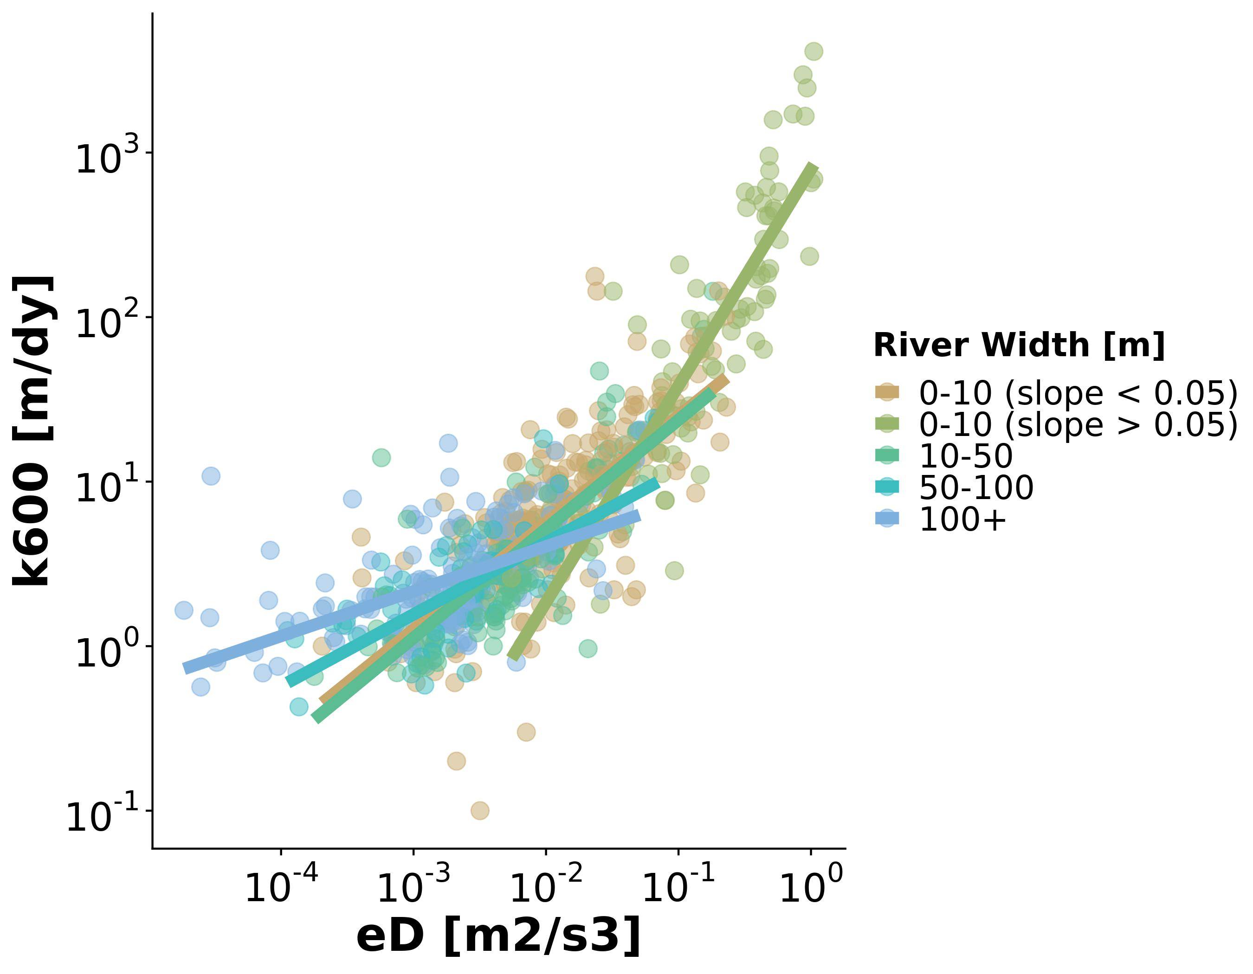
Colin wanted me to revisit the equations I was using to something to something more defensible
Ended up down a rabbit hole that is pushing further and further from a remote sensing paper….

Slide 2
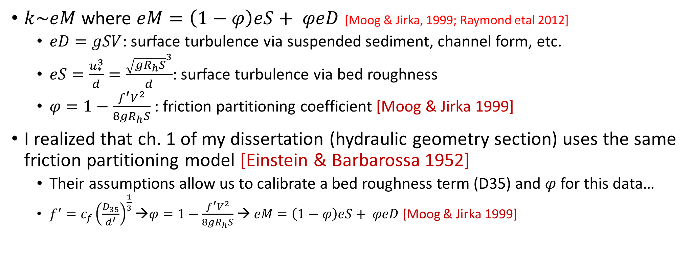
$k\sim eM$ where $eM=\left(1−φ\right)eS+ φeD$ [Moog & Jirka, 1999; Raymond etal 2012]
$eD=gSV$: surface turbulence via suspended sediment, channel form, etc.
$eS=\frac{u_{∗}^{3}}{d}=\frac{{\sqrt{gR_{h}S}}^{3}}{d}$: surface turbulence via bed roughness
$φ=1−\frac{f^{′}V^{2}}{8gR_{h}S}$ : friction partitioning coefficient [Moog & Jirka 1999]
I realized that ch. 1 of my dissertation (hydraulic geometry section) uses the same friction partitioning model [Einstein & Barbarossa 1952]
Their assumptions allow us to calibrate a bed roughness term (D35) and $φ$ for this data…
$f^{′}=c_{f}{\left(\frac{D_{35}}{d^{′}}\right)}^{\frac{1}{3}}$ →$φ=1−\frac{f^{′}V^{2}}{8gR_{h}S}$ → $eM=\left(1−φ\right)eS+ φeD$ [Moog & Jirka 1999]

Slide 3
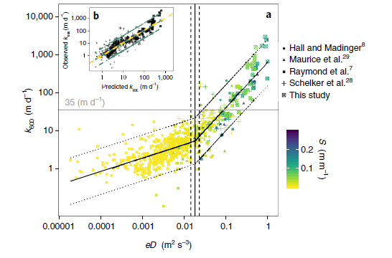
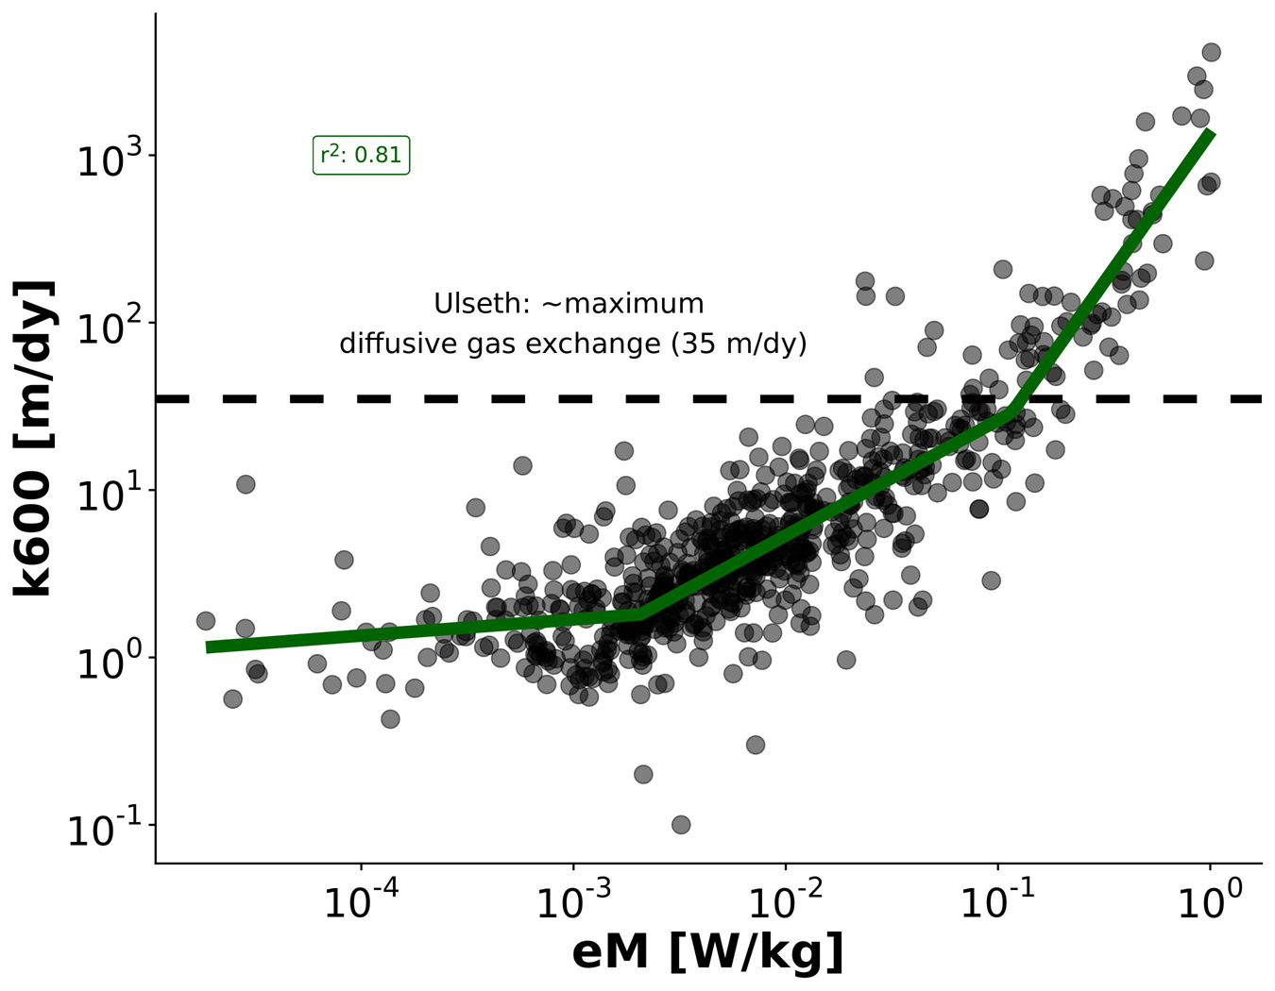
K600 ~ eM relationship
1) Upper breakpoint is now synonymous with the threshold proposed by Ulseth for max k from diffusion alone
2) Can I justify the lower breakpoint?
I’ve always figured in big rivers, turbulence is super low and k is increasingly ~decoupled from eM.
R²: 0.78
Ulseth etal (2019)

Slide 4
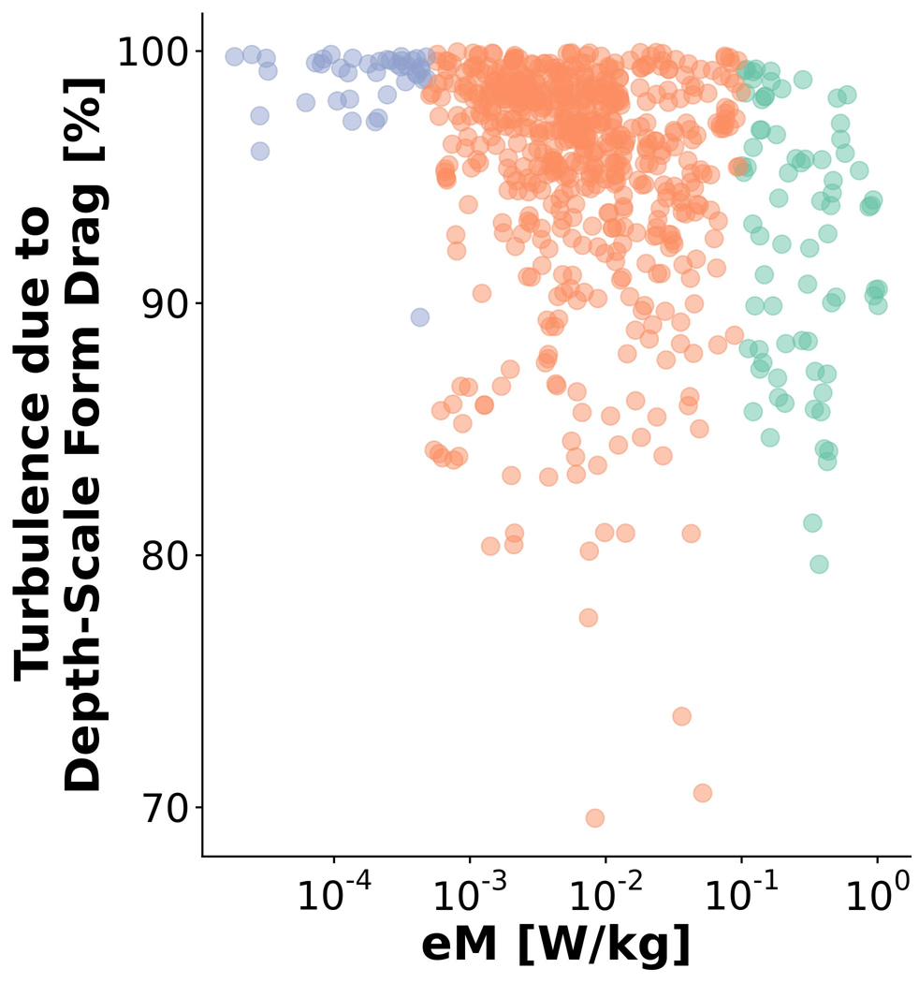
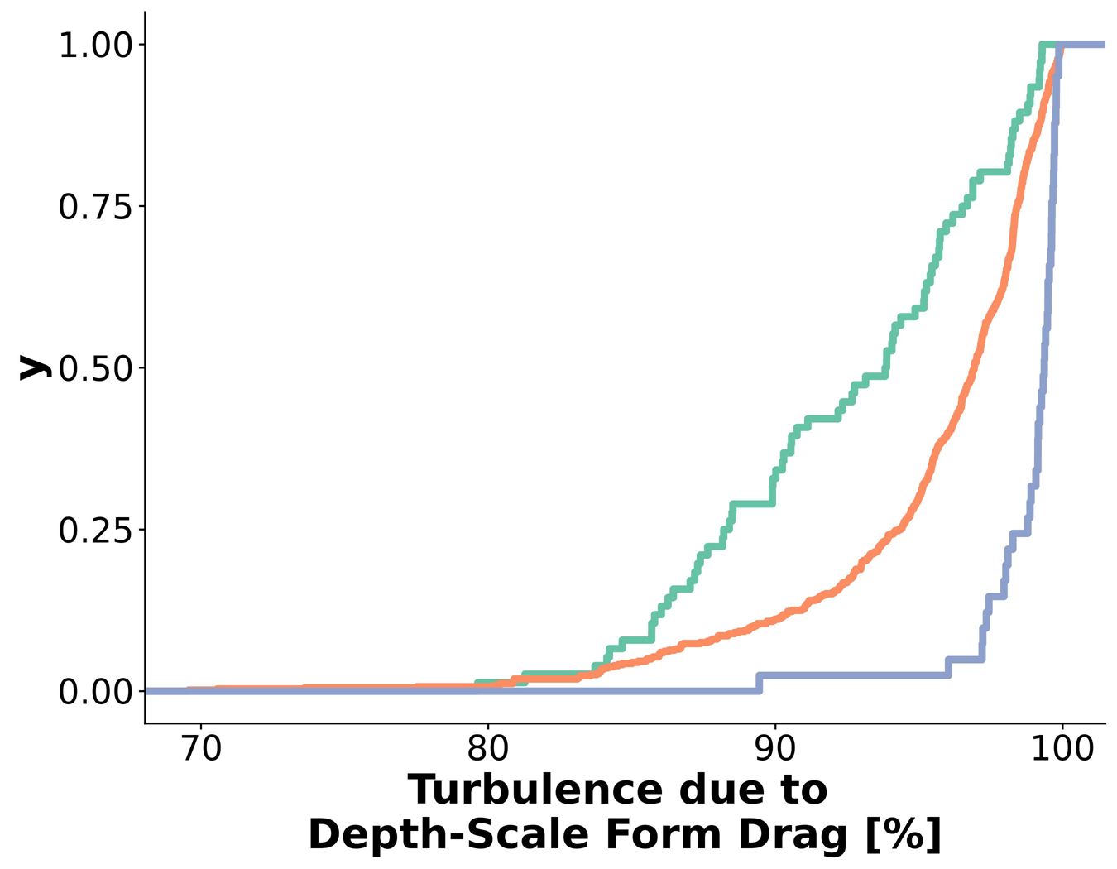

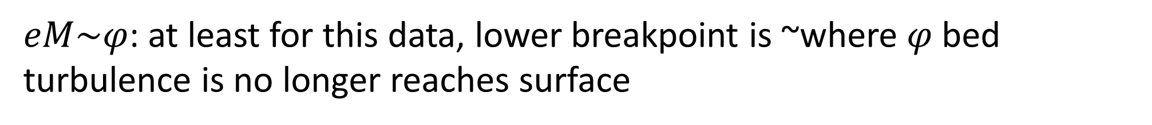

$eM\sim φ$: at least for this data, lower breakpoint is ~where $φ$ bed turbulence is no longer reaches surface
$$φ:$$

Slide 5
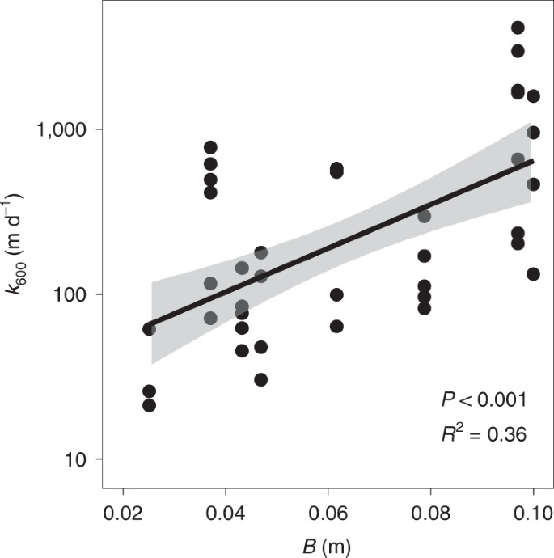
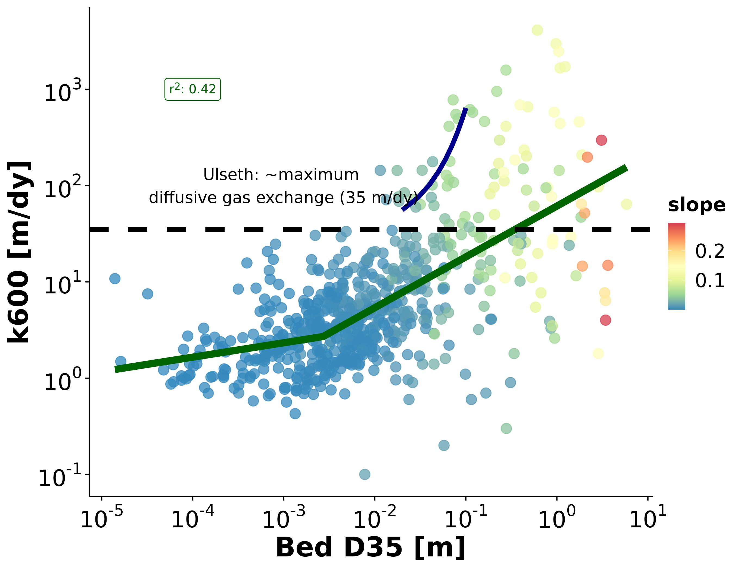
Same massive residuals (~10-1000 m/day) as Ulseth model, which measured roughness in the field
Ulseth etal (2019)

Slide 6
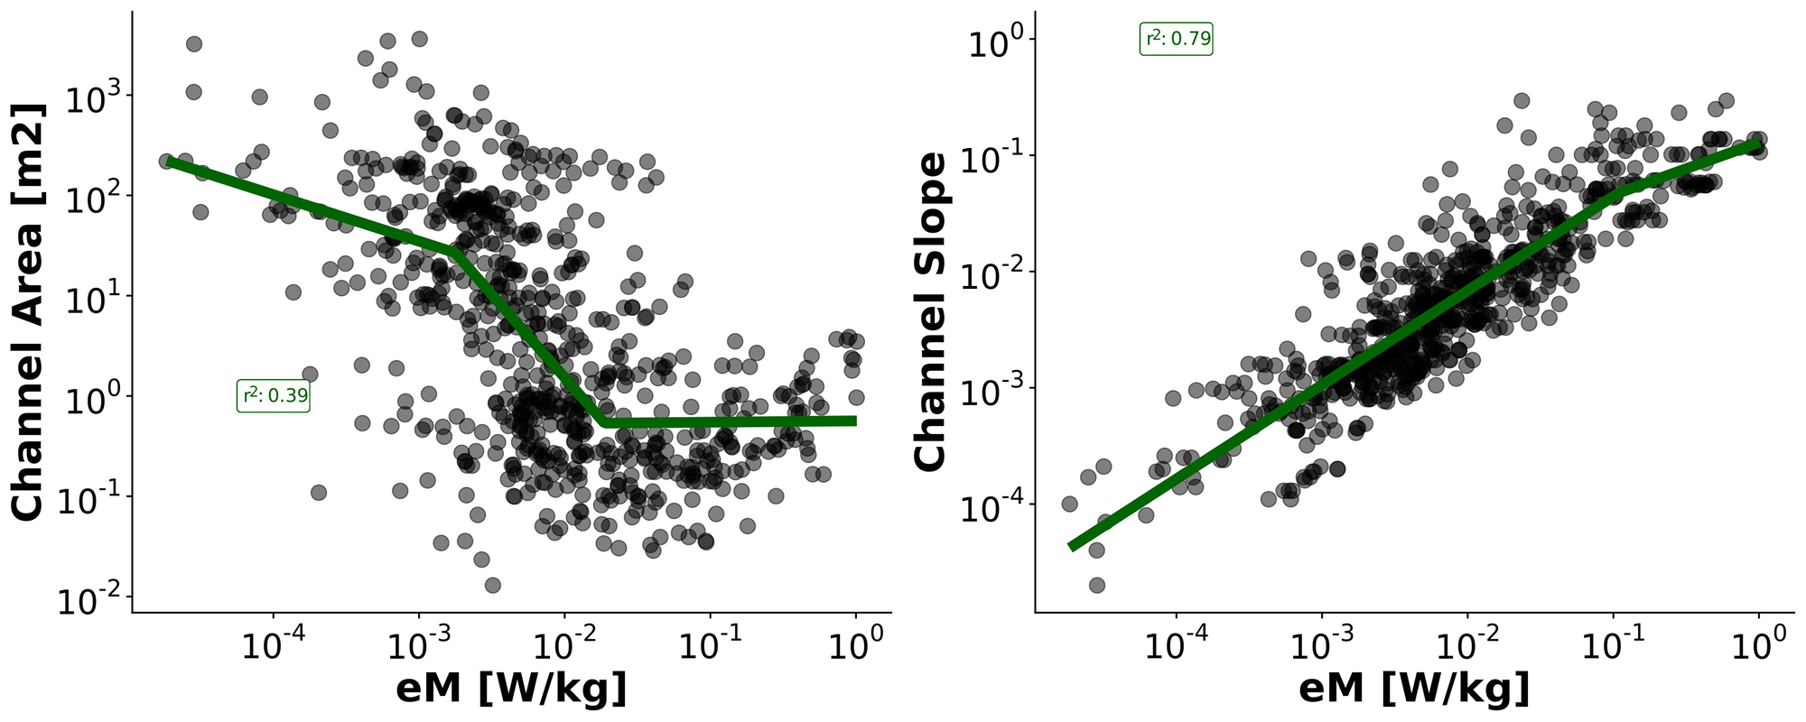
eM vs channel properties
These regressions are fit independently of the purple breakpoints

Slide 7
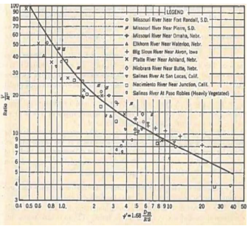
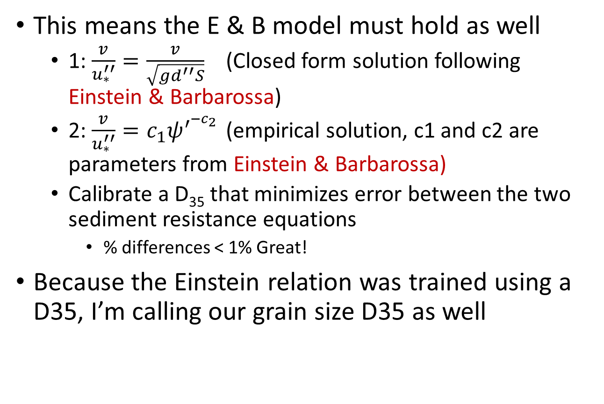
Approach
Assume friction can be portioned following Moog & Jirka (1999) who presumably follow Einstein & Barbarossa (1952)
$f=f^{′}+f^{′′}$ → $d=d^{′}+d^{′′}$
This means the E & B model must hold as well
1: $\frac{v}{u_{∗}^{′′}}=\frac{v}{\sqrt{gd^{′′}S}}$ (Closed form solution following Einstein & Barbarossa)
2: $\frac{v}{u_{∗}^{′′}}=c_{1}ψ^{′^{{−c}_{2}}}$ (empirical solution, c1 and c2 are parameters from Einstein & Barbarossa)
Calibrate a D₃₅ that minimizes error between the two sediment resistance equations
% differences < 1% Great!
Because the Einstein relation was trained using a D35, I’m calling our grain size D35 as well
f(Suspended grain resistance)
f(Bed form resistance)
<----------------------------RIVER SIZE

Slide 8
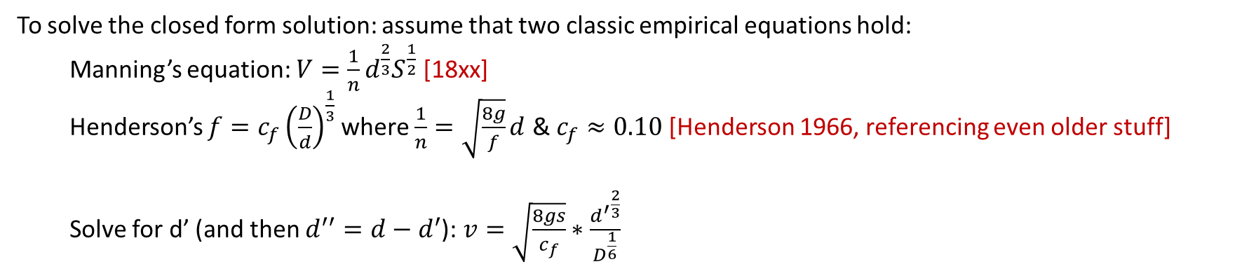
To solve the closed form solution: assume that two classic empirical equations hold:
Manning’s equation: $V=\frac{1}{n}d^{\frac{2}{3}}S^{\frac{1}{2}}$ [18xx]
Henderson’s $f=c_{f}{\left(\frac{D}{d}\right)}^{\frac{1}{3}}$ where $\frac{1}{n}=\sqrt{\frac{8g}{f}}d$ & $c_{f}≈0.10$[Henderson 1966, referencing even older stuff]
Solve for d’ (and then $d^{′′}=d−d^{′}$): $v=\sqrt{\frac{8gs}{c_{f}}}∗\frac{{d^{′}}^{\frac{2}{3}}}{D^{\frac{1}{6}}}$

